Slide 1
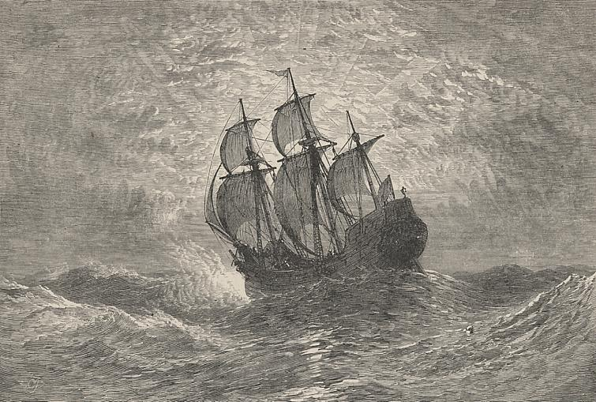
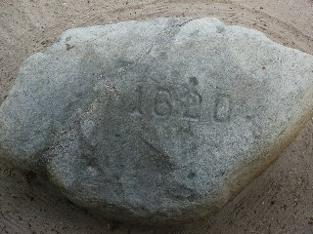
THE PURITANS
1620-1720

Slide 2
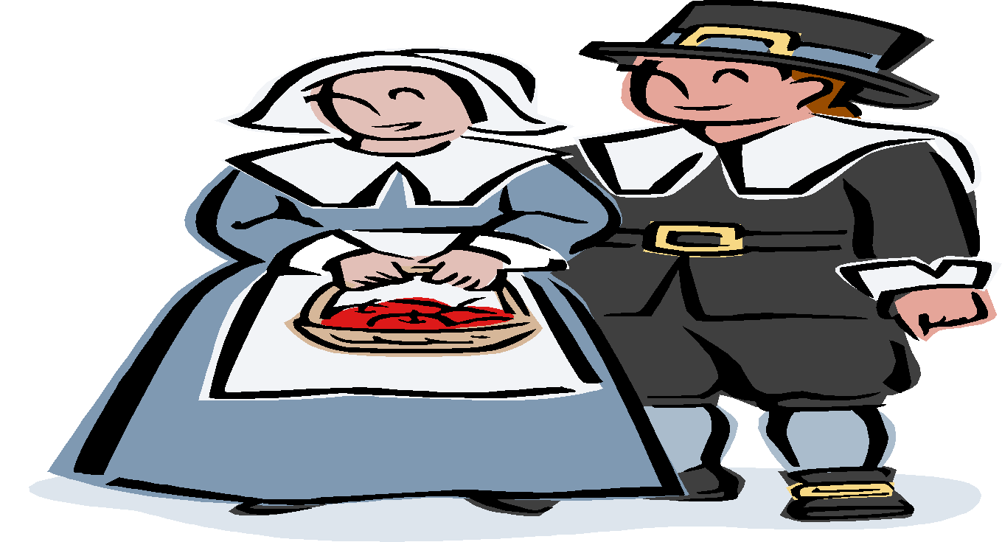
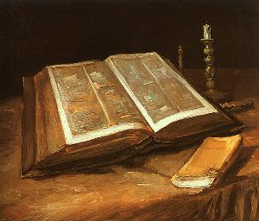
WHO WERE THE PURITANS?
Puritan refers to a number of Protestant groups that sought to “purify” the Church of England of its corruptions
Believed that religion is a personal, inner experience; therefore, a clergy cannot act as an intermediary between the individual and God.
Emphasized simplicity, sobriety, religious earnestness, and personal self-control. STRICT adherence to the teachings of the Bible was also required.
Notes:
‹#›

Slide 3
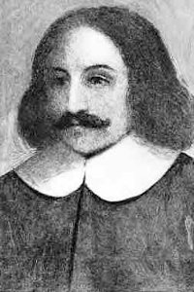
WHO WERE THE PURITANS?
They were viewed in England as religious extremists who were very conservative morally and fear to be potential political revolutionaries.
Puritan belief in a more democratic church organization carried potential political implications
If church organization was no longer “top-down,” could government change as well?
Absolute monarchs feared this reorganization
As a result, Puritans were harassed and persecuted in England
William Bradford led a small group of Puritans to the New World to escape persecution in England in 1620.

Slide 4
WHY DID THEY COME TO AMERICA?
To escape persecution
To find religious freedom
To make money: they were good businessmen and hard workers. Most puritans were well-educated, cultured, and of good family.
To establish a “City on a Hill”
An exemplary religious community that all could see, admire, and emulate
Could only do this is an uninhabited, uncivilized, undeveloped land where they had total freedom and where they were not overshadowed by other cultures.
Notes:
‹#›

Slide 5
Tenets of Puritan Theology
God is a God of authority, a king and ruler
Our duty in this world is to see that God’s will prevails
We discover what God wants us to do by reading the Bible
Because of Adam’s fall, mankind is totally depraved from birth
Some few of us will be saved as an undeserved gift from God (grace)
For the chosen few, the “elect,” God’s grace is predestined and irresistible. The saved come to know of their election by inner voices and by the godly spirit shown in all their actions. The damned are damned despite their best efforts.

Slide 6
STRONG BELIEF IN PREDESTINATION
God selects those to be “saved,” taken to heaven, before they are even born
One cannot influence God’s decision during life: it can’t be changed
One cannot know for sure whether one is “saved” or “damned”
ALL humans deserve damnation; only through God’s bestowal of grace due to His infinite mercy are a few saved
Notes:
‹#›

Slide 7
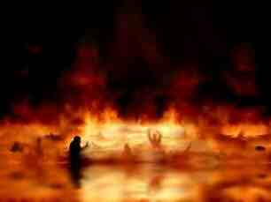
THE ELECT VS. THE DAMNED
The Elect are those chosen for heaven.
They are few compared to the damned
The Damned are those going to hell
They are many
ALL deserve damnation due to our depraved and evil nature
It is only through God’s infinite mercy that even a single person is saved from hell
Notes:
‹#›

Slide 8
HUMAN NATURE AND “THE FALL”
Human Nature is EVIL: we are born to sin and are drawn towards it as our natural impulse
It is evil due to “Original Sin”
Adam and Eve’s disobedience in the Garden of Eden: also called “The Fall”
All humans inherit Adam and Eve’s sin—so even newborn babies are not innocent.
Thus it is our nature to do evil, to disobey, to rebel despite God’s great kindness in creating us
Notes:
‹#›

Slide 9
GRACE
You could feel God’s presence entering you in the form of “Grace.”
This was an overwhelming feeling of joy and exhilaration
They searched their lives and hearts and souls for signs of grace: this they felt, was proof that God had chosen them as one of the Elect.
Notes:
‹#›

Slide 10
WHY DO GOOD INSTEAD OF EVIL?
If your action on earth do not influence whether you go to heaven or hell, why do good?
Puritan logic suggests the following:
God wouldn’t choose someone to go to heaven who was evil or corrupt
So, you act holy to try to convince yourself that you would be good enough for God to have chosen you
Grace is the only “proof” you might have
However, we are imperfect and we have an evil nature, so we will naturally always revert to sin . . .
Notes:
‹#›

Slide 11
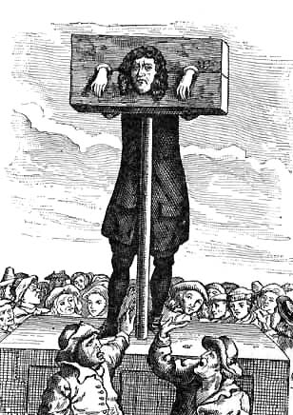
CRIMES IN PURITAN SOCIETY
Sinning = crime
Ex.: Adultery was a sin, and also a crime: could be punished in court for it.
The Bible was literal word of God
So, any deviance from the teaching therein was a sin, and thus a crime
Extremely strict morally:
Dancing, showing any skin, playing cards, wearing ostentatious clothing, any sort of sexual misconduct, were all sins. Having fun was a SIN! (at least it seemed like it)
Notes:
‹#›

Slide 12
THE DIFFICULTY OF THE PURITAN EXISTENCE
They were a very serious, dour people under enormous stress constantly
Everything is a sin
We are by nature evil so we have no real chance of avoiding sin for long
God damns most people—and we all deserve it
We can’t change God’s decision (predestination)
We can’t even KNOW if we are saved or not
Everyone watching over you constantly to control your behavior and keep you from sinning (or to tell on you)
No way to really confess sins due to the harsh judgments of the community: so no way to expiate guilt
Purely human impulses are harshly punished and never forgotten or forgiven
Notes:
‹#›

Slide 13
THE PURITAN CREED
Human beings are sinful by nature.
Salvation belongs to the elect, or God’s chosen, who can be identified by virtue.
Hard work and worldly success are signs of God’s grace.
Education is essential in order to read the word of God.
A person should be thrifty, modest, and simple.
Society should be ruled by covenants that parallel God’s covenant with His people.

Slide 14
Nature vs. the Community
VNature was seen as frightening, potentially a place of evil, and always a place of temptation
VYou fear what you don’t understand: this is pre-science so didn’t understand nature; thus, they feared it
VWithout the strict rules of the community, harsh punishments for sin, and the authorities to enforce punishments, our evil nature would take over
VYou don’t have these restrictions in Nature to keep you on the straight and narrow—thus we would were more likely to sin in nature than in the community

Slide 15
Puritan Virtues
V Sobriety
V Temperance
V Industriousness...“Idle hands are the Devil’s workshop.”
V Simplicity...In dress, lifestyle, worship
V Self-Reliance
V***Just by chance, these are EXACTLY the characteristics it would take to survive in the New World

Slide 16
Puritan Literature
Sermons
Histories
Journals
Some poetry
Very little creative literature
Little concern for beauty
Total focus is on God, following God’s will as outlined in the Bible, and the afterlife

Slide 17
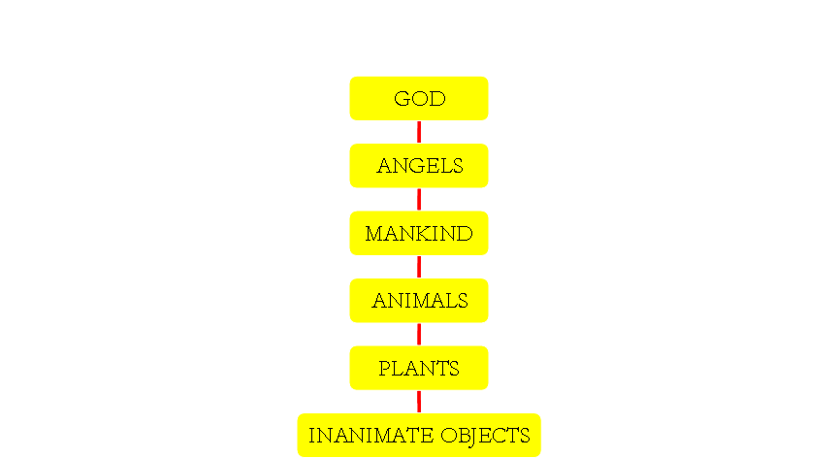
THE MEDIEVAL PARADIGM: THE GREAT CHAIN OF BEING
A hierarchy; each level is subordinate to the one above it
No concept of democracy or equality in this worldview; a clear order of superiority/inferiority and absolute obedience to those above
This carried over to the way they organized politically and socially
Each level, other than God, has sublevels

Slide 18
THINK ABOUT IT...
How many of these Puritan beliefs are still valued in America?
Where do you see Americans still following the Puritan creed and where do you see them abandoning these beliefs?
Back up your opinions with logical arguments and specific examples.

